Slide 1

Fundamentals of Python:
First Programs
Chapter 3: Control Statements

Slide 2

Objectives
After completing this chapter, you will be able to:
Write a loop to repeat a sequence of actions a fixed number of times
Write a loop to traverse the sequence of characters in a string
Write a loop that counts down and a loop that counts up
Write an entry-controlled loop that halts when a condition becomes false
Fundamentals of Python: First Programs

Slide 3
Objectives (continued)
Use selection statements to make choices in a program
Construct appropriate conditions for condition-controlled loops and selection statements
Use logical operators to construct compound Boolean expressions
Use a selection statement and a break statement to exit a loop that is not entry-controlled
Fundamentals of Python: First Programs

Slide 4
Definite Iteration: The for Loop
Repetition statements (or loops) repeat an action
Each repetition of action is known as pass or iteration
Two types of loops
  Those that repeat action a predefined number of times (definite iteration)
  Those that perform action until program determines it needs to stop (indefinite iteration)
Fundamentals of Python: First Programs

Slide 5
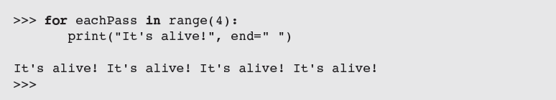
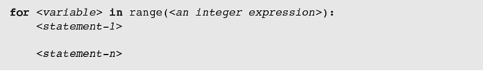
Executing a Statement a Given Number of Times
Python’s for loop is the control statement that most easily supports definite iteration
The form of this type of loop is:
loop header
loop body
statements in body must be indented and aligned in the same column
Fundamentals of Python: First Programs

Slide 6
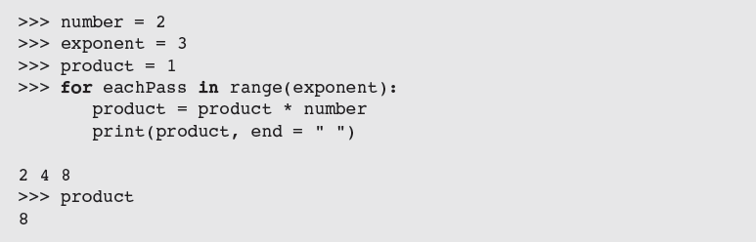
Executing a Statement a Given Number of Times (continued)
Example: Loop to compute an exponentiation for a non-negative exponent
If the exponent were 0, the loop body would not execute and value of product would remain as 1
Fundamentals of Python: First Programs

Slide 7
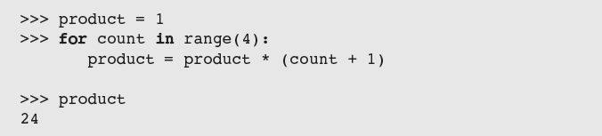
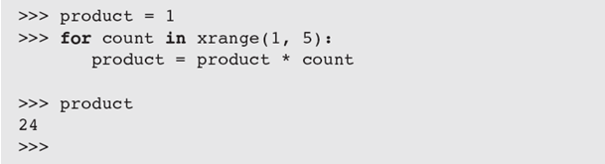
Count-Controlled Loops
Loops that count through a range of numbers
To specify a explicit lower bound:
Fundamentals of Python: First Programs

Slide 8
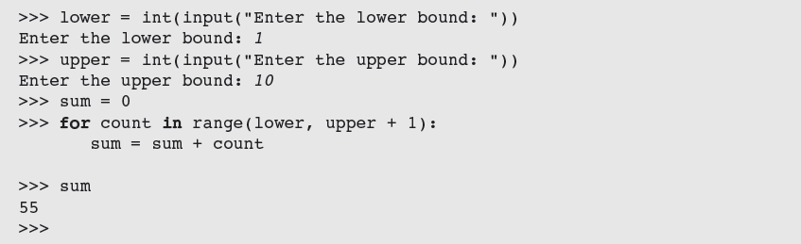
Count-Controlled Loops (continued)
Example: bound-delimited summation
Fundamentals of Python: First Programs

Slide 9
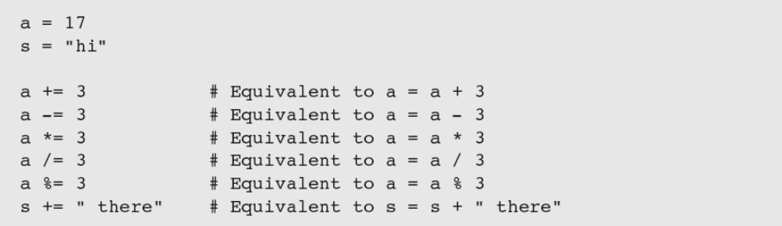
Augmented Assignment
Augmented assignment operations:
Format:
Equivalent to:
Fundamentals of Python: First Programs

Slide 10
Loop Errors: Off-by-One Error
Example:
Loop actually counts from 1 through 3
This is not a syntax error, but rather a logic error
Fundamentals of Python: First Programs

Slide 11
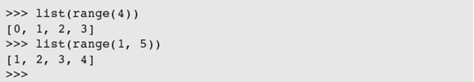

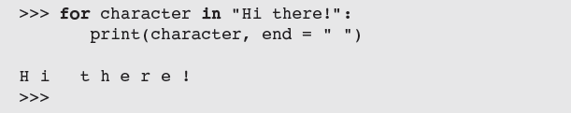
Traversing the Contents of a Data Sequence
range returns a list
Strings are also sequences of characters
Values in a sequence can be visited with a for loop:
Example:
Fundamentals of Python: First Programs

Slide 12
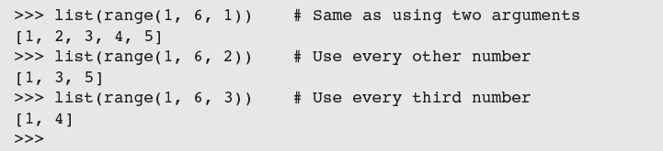
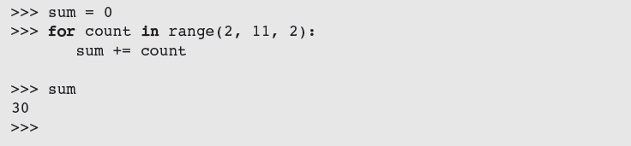
Specifying the Steps in the Range
range expects a third argument that allows you specify a step value
Example in a loop:
Fundamentals of Python: First Programs

Slide 13
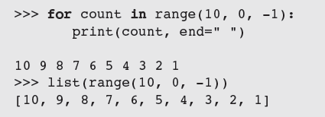
Loops That Count Down
Example:
Fundamentals of Python: First Programs

Slide 14
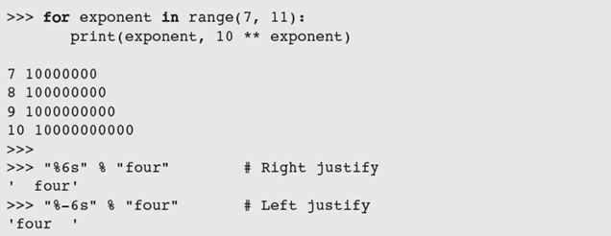
Formatting Text for Output
Many data-processing applications require output that has tabular format
Field width: Total number of data characters and additional spaces for a datum in a formatted string
Fundamentals of Python: First Programs

Slide 15
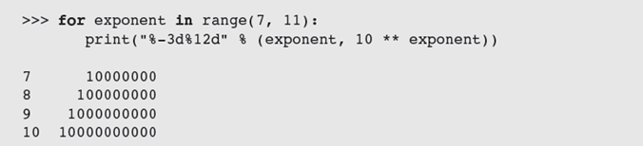
Formatting Text for Output (continued)
  This version contains format string, format operator %, and single data value to be formatted
  To format integers, letter d is used instead of s
To format sequence of data values:
Fundamentals of Python: First Programs

Slide 16
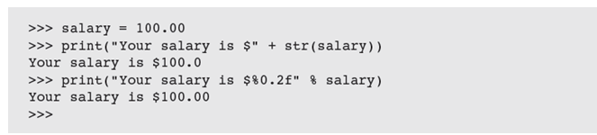
Formatting Text for Output (continued)
To format data value of type float:
where .<precision> is optional
Examples:
Fundamentals of Python: First Programs

Slide 17
Case Study: An Investment Report
Request:
  Write a program that computes an investment report
Fundamentals of Python: First Programs

Slide 18
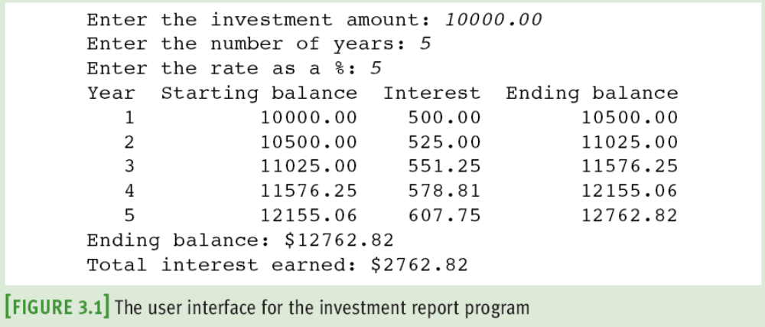
Case Study: An Investment Report (continued)
Analysis:
Fundamentals of Python: First Programs

Slide 19
Case Study: An Investment Report (continued)
Design:
  Receive the user’s inputs and initialize data
  Display the table’s header
  Compute results for each year and display them
  Display the totals
Fundamentals of Python: First Programs

Slide 20
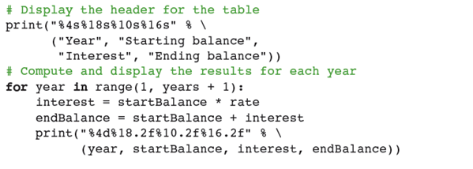

Case Study: An Investment Report (continued)
Coding:
Fundamentals of Python: First Programs

Slide 21
Selection: if and if-else Statements
Selection statements allow a computer to make choices
  Based on a condition
Fundamentals of Python: First Programs

Slide 22
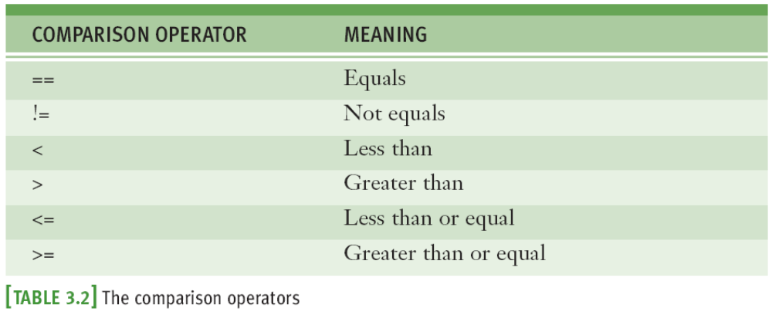
The Boolean Type, Comparisons, and Boolean Expressions
Boolean data type consists of two values: true and false (typically through standard True/False)
Example: 4 != 4 evaluates to False
Fundamentals of Python: First Programs

Slide 23
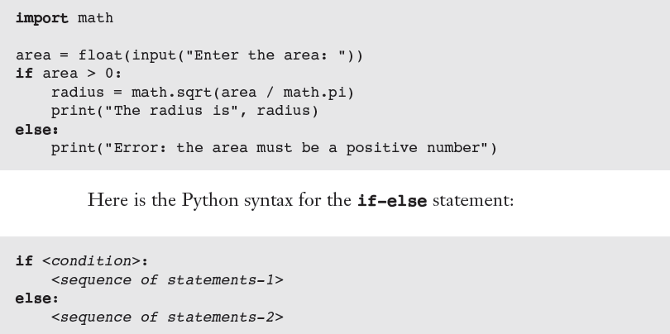

if-else Statements
Also called a two-way selection statement
Often used to check inputs for errors:
Syntax:
Fundamentals of Python: First Programs

Slide 24
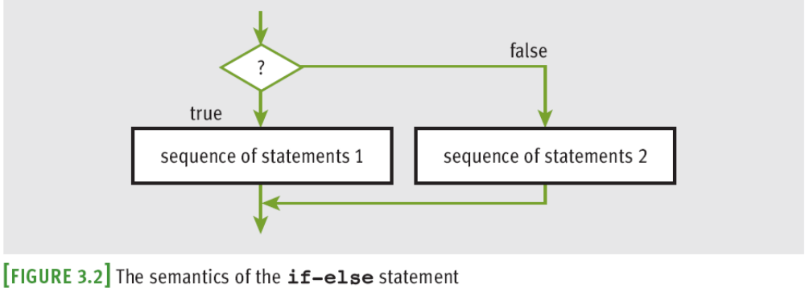
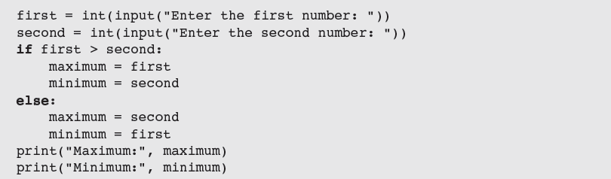
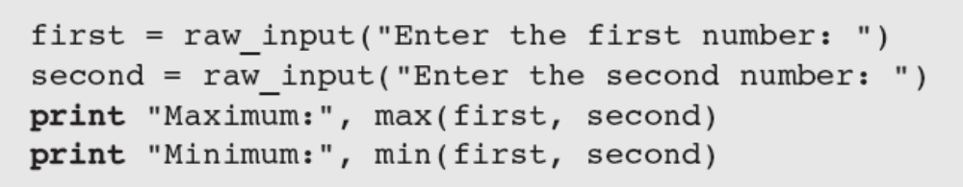

if-else Statements (continued)
must be a Boolean expression
Better alternative:
Fundamentals of Python: First Programs

Slide 25
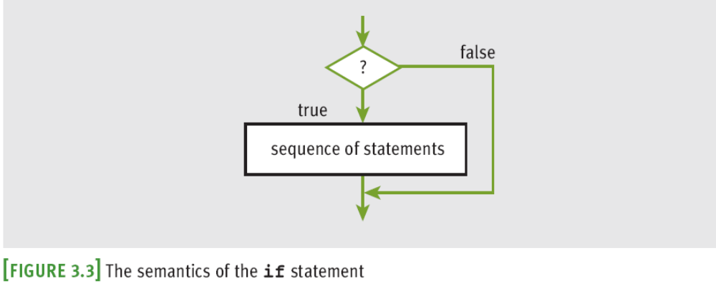
One-Way Selection Statements
Simplest form of selection is the if statement
Fundamentals of Python: First Programs

Slide 26
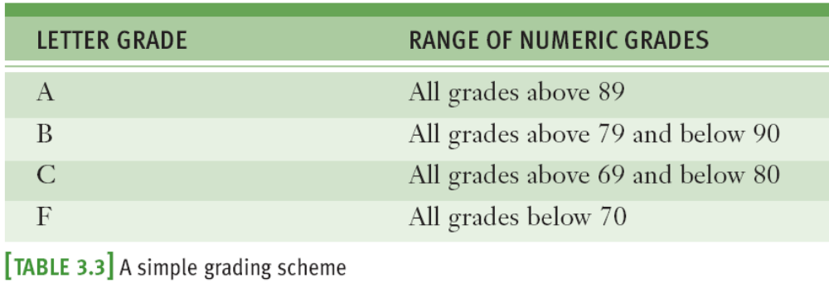
Multi-way if Statements
A program may be faced with testing conditions that entail more than two alternative courses of action
Can be described in code by a multi-way selection statement
Fundamentals of Python: First Programs

Slide 27
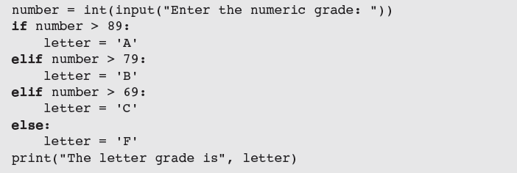
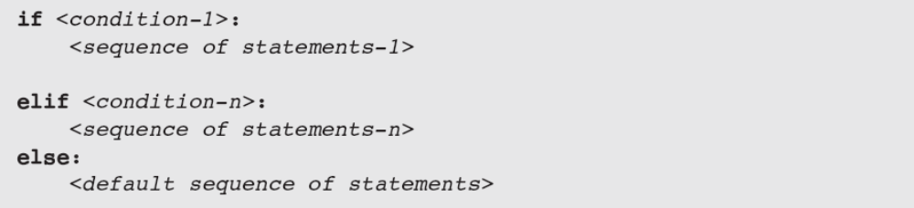
Multi-way if Statements (continued)
Syntax:
Fundamentals of Python: First Programs

Slide 28
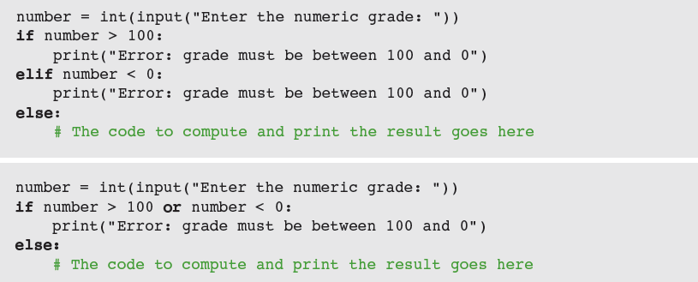
Logical Operators and Compound Boolean Expressions
Often a course of action must be taken if either of two conditions is true: Below are two approaches
  Could we use the and logical operator instead?
Fundamentals of Python: First Programs

Slide 29
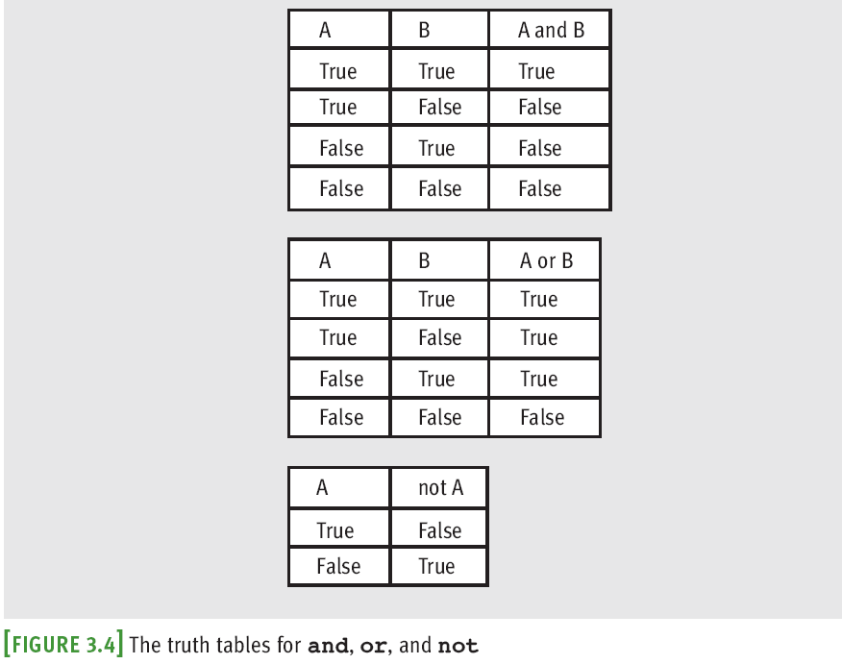
Logical Operators and Compound Boolean Expressions (continued)
Fundamentals of Python: First Programs

Slide 30
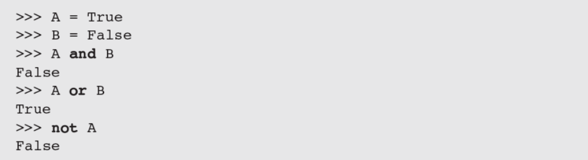
Logical Operators and Compound Boolean Expressions (continued)
Next example verifies some of the claims made in the previous truth tables:
The logical operators are evaluated after comparisons but before the assignment operator
  not has higher precedence than and and or
Fundamentals of Python: First Programs

Slide 31
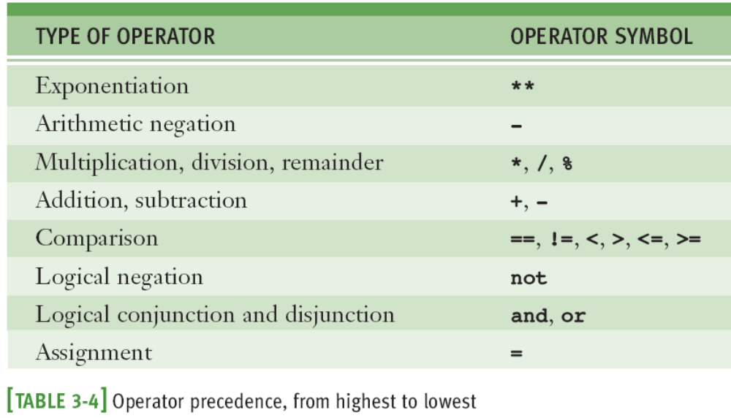
Logical Operators and Compound Boolean Expressions (continued)
Fundamentals of Python: First Programs

Slide 32
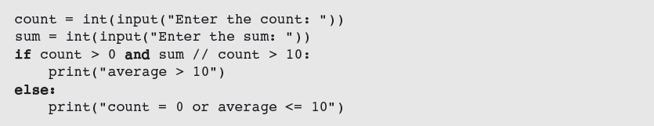

Short-Circuit Evaluation
In (A and B), if A is false, then so is the expression, and there is no need to evaluate B
In (A or B), if A is true, then so is the expression, and there is no need to evaluate B
Short-circuit evaluation: Evaluation stops as soon as possible
Fundamentals of Python: First Programs

Slide 33
Testing Selection Statements
Tips:
  Make sure that all of the possible branches or alternatives in a selection statement are exercised
  After testing all of the actions, examine all of the conditions
  Test conditions that contain compound Boolean expressions using data that produce all of the possible combinations of values of the operands
Fundamentals of Python: First Programs

Slide 34
Conditional Iteration: The while Loop
The while loop can be used to describe conditional iteration
  Example: A program’s input loop that accepts values until user enters a sentinel that terminates the input
Fundamentals of Python: First Programs

Slide 35
The Structure and Behavior of a while Loop
Conditional iteration requires that condition be tested within loop to determine if it should continue
  Called continuation condition
  Improper use may lead to infinite loop
while loop is also called entry-control loop
  Condition is tested at top of loop
  Statements within loop can execute zero or more times
Fundamentals of Python: First Programs

Slide 36
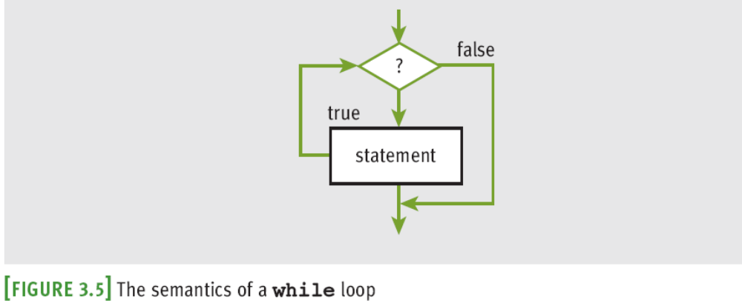
The Structure and Behavior of a while Loop (continued)
Fundamentals of Python: First Programs

Slide 37
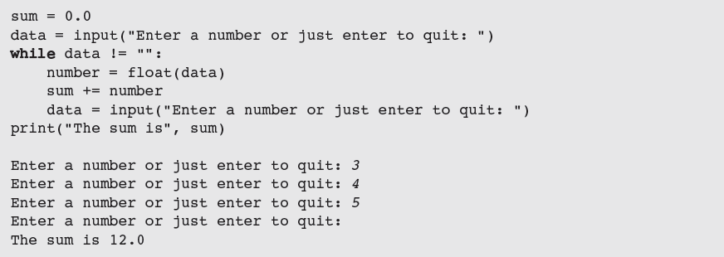
The Structure and Behavior of a while Loop (continued)
data is the loop control variable
Fundamentals of Python: First Programs

Slide 38
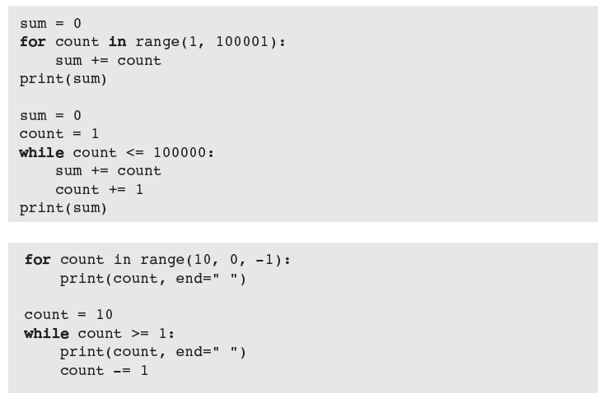
Count Control with a while Loop
Fundamentals of Python: First Programs

Slide 39
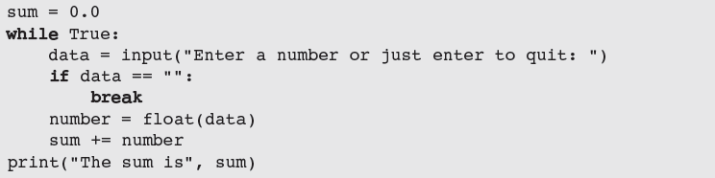
The while True Loop and the break Statement
while loop can be complicated to write correctly
  Possible to simplify its structure and improve its readability
Fundamentals of Python: First Programs

Slide 40
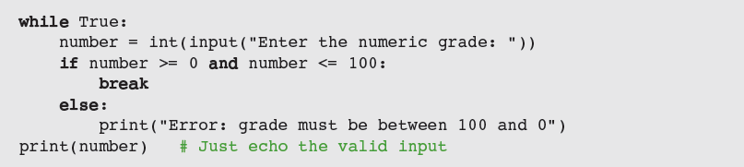
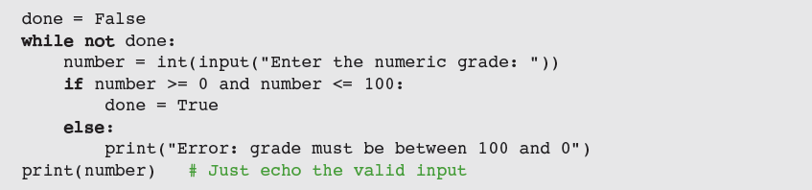
The while True Loop and the break Statement (continued)
Alternative: Use a Boolean variable to control loop
Fundamentals of Python: First Programs

Slide 41
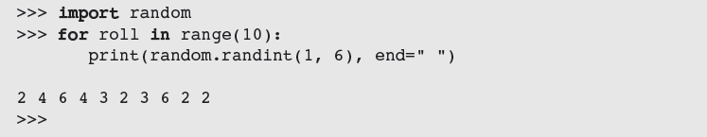
Random Numbers
Programming languages include resources for generating random numbers
random module supports several ways to do this
  randint returns random number from among numbers between two arguments, included
Example: A simple guessing game
Fundamentals of Python: First Programs

Slide 42
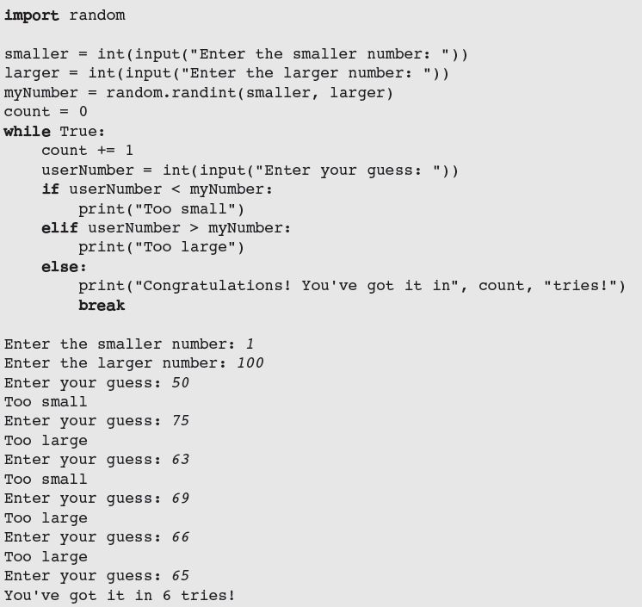
Random Numbers (continued)
Fundamentals of Python: First Programs

Slide 43
Loop Logic, Errors, and Testing
Errors to rule out during testing while loop:
  Incorrectly initialized loop control variable
  Failure to update this variable correctly within loop
  Failure to test it correctly in continuation condition
To halt loop that appears to hang during testing, type Control+c in terminal window or IDLE shell
If loop must run at least once, use a while True loop with delayed examination of termination condition
  Ensure a break statement to be reached eventually
Fundamentals of Python: First Programs

Slide 44
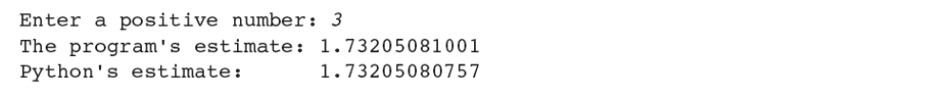
Case Study: Approximating Square Roots
Request:
  Write a program that computes square roots
Analysis:
Design:
  Use Newton’s square root approximation algorithm:
    Square root y of a positive number x is the number y such that y² = x
    If initial estimate of y is z, a better estimate of y can be obtained by taking the average of z together with x/z
Fundamentals of Python: First Programs

Slide 45
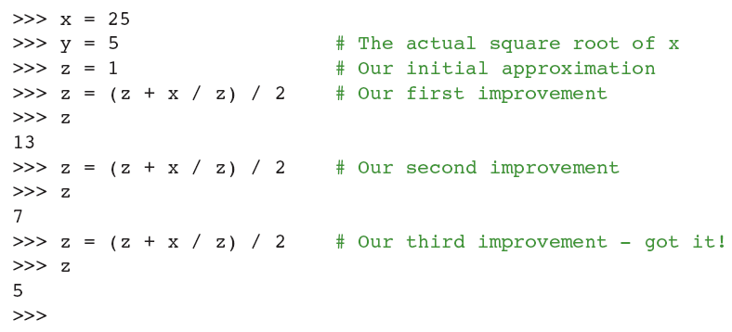
Case Study: Approximating Square Roots (continued)
A quick session with the Python interpreter shows this method of successive approximations in action:
Fundamentals of Python: First Programs

Slide 46
Case Study: Approximating Square Roots (continued)
Design (continued): Algorithm
  set x to the user’s input value
  set tolerance to 0.000001
  set estimate to 1.0
  while True
    set estimate to (estimate + x / estimate) / 2
    set difference to abs(x - estimate ** 2)
    if difference <= tolerance:
    break
  output the estimate
Fundamentals of Python: First Programs

Slide 47
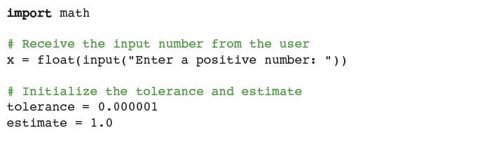
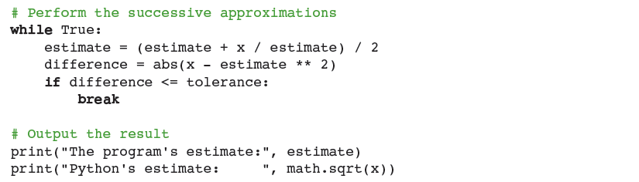
Case Study: Approximating Square Roots (continued)
Implementation (Coding):
Fundamentals of Python: First Programs

Slide 48
Summary
Control statements determine order in which other statements are executed in program
Definite iteration is process of executing set of statements fixed, predictable number of times
  Example: use for loop
for loop consists of header and set of statements called body
  Can be used to implement a count-controlled loop
    Use range to generate sequence of numbers
  Can traverse and visit the values in any sequence
Fundamentals of Python: First Programs

Slide 49
Summary (continued)
A format string and its operator % allow programmer to format data using field width and precision
An off-by-one error occurs when loop does not perform intended number of iterations, there being one too many or one too few
Boolean expressions evaluate to True or False
  Constructed using logical operators: and, or, not
  Python uses short-circuit evaluation in compound Boolean expressions
Selection statements enable program to make choices
Fundamentals of Python: First Programs

Slide 50
Summary (continued)
if-else is a two-way selection statement
Conditional iteration is the process of executing a set of statements while a condition is true
  Use while loop (which is an entry-control loop)
A break can be used to exit a loop from its body
Any for loop can be converted to an equivalent while loop
Infinite loop: Continuation condition never becomes false and no other exit points are provided
random.randint returns a random number
Fundamentals of Python: First Programs

